Slide 1
Integration of renewable energies: competition between storage, the power grid and flexible demand
Thomas Hamacher

Slide 2
Introduction

Slide 3
Introduction
New market
mechanism
Cross sector
coupling
New power
system
New controls
New hierarchy of
system
Micro-grid

Slide 4
Energy models
Energy Models
Human behaviour
Technology
Technological change
Economy
Environment

Slide 5
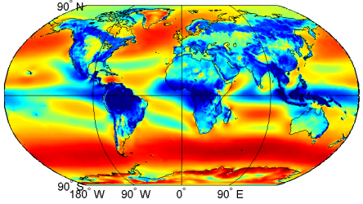
Database of renewable energies generation time series
Data processing based on different input data
End products
  Time series data
Renewable energies generation time series for modeling and statistical analysis
  Data source
  NASA: MERRA-Reanalysis dataset
  ~1,7 bn. data points per variable per year
  Available variables
  Wind speed in 50 m
  Radiation
  Temperature in 2 m
  Air pressure
  Others
1/2 °resolution
→ 361 data points
1 hour resolution → 8760/8784
data points
  Available timeframe
2/3 °resolution → 540 data points
  1979 – “now”
Illustrations (pictures and videos) for reports and lectures
  Static Data
  Data source
  Available data
  NASA
  Other US/EU Agencies
  Universities
  Earth surface properties (land/sea, elevation, roughness of surface, …)
  Country/region boundaries
  Others
Source Janker
5

Slide 6
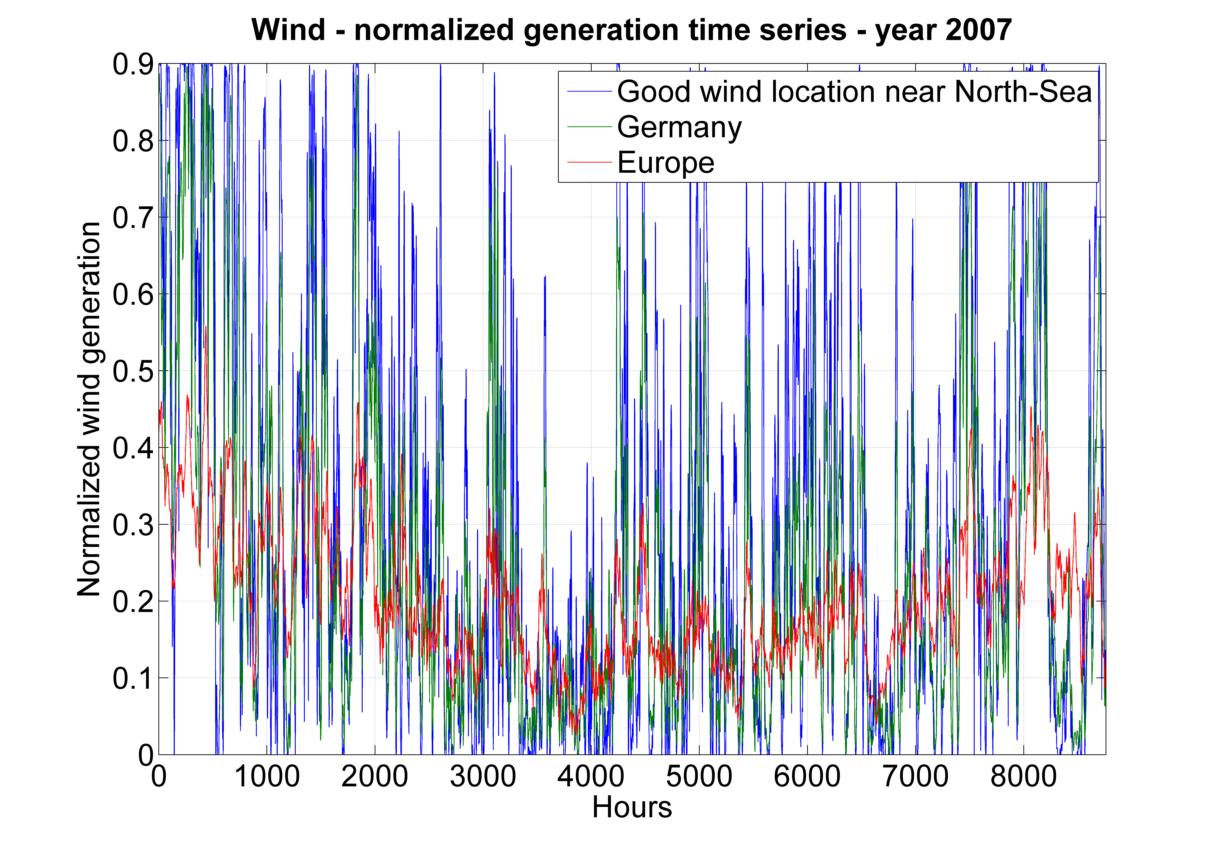
Warming up with wind-statistics
Source Janker

Slide 7
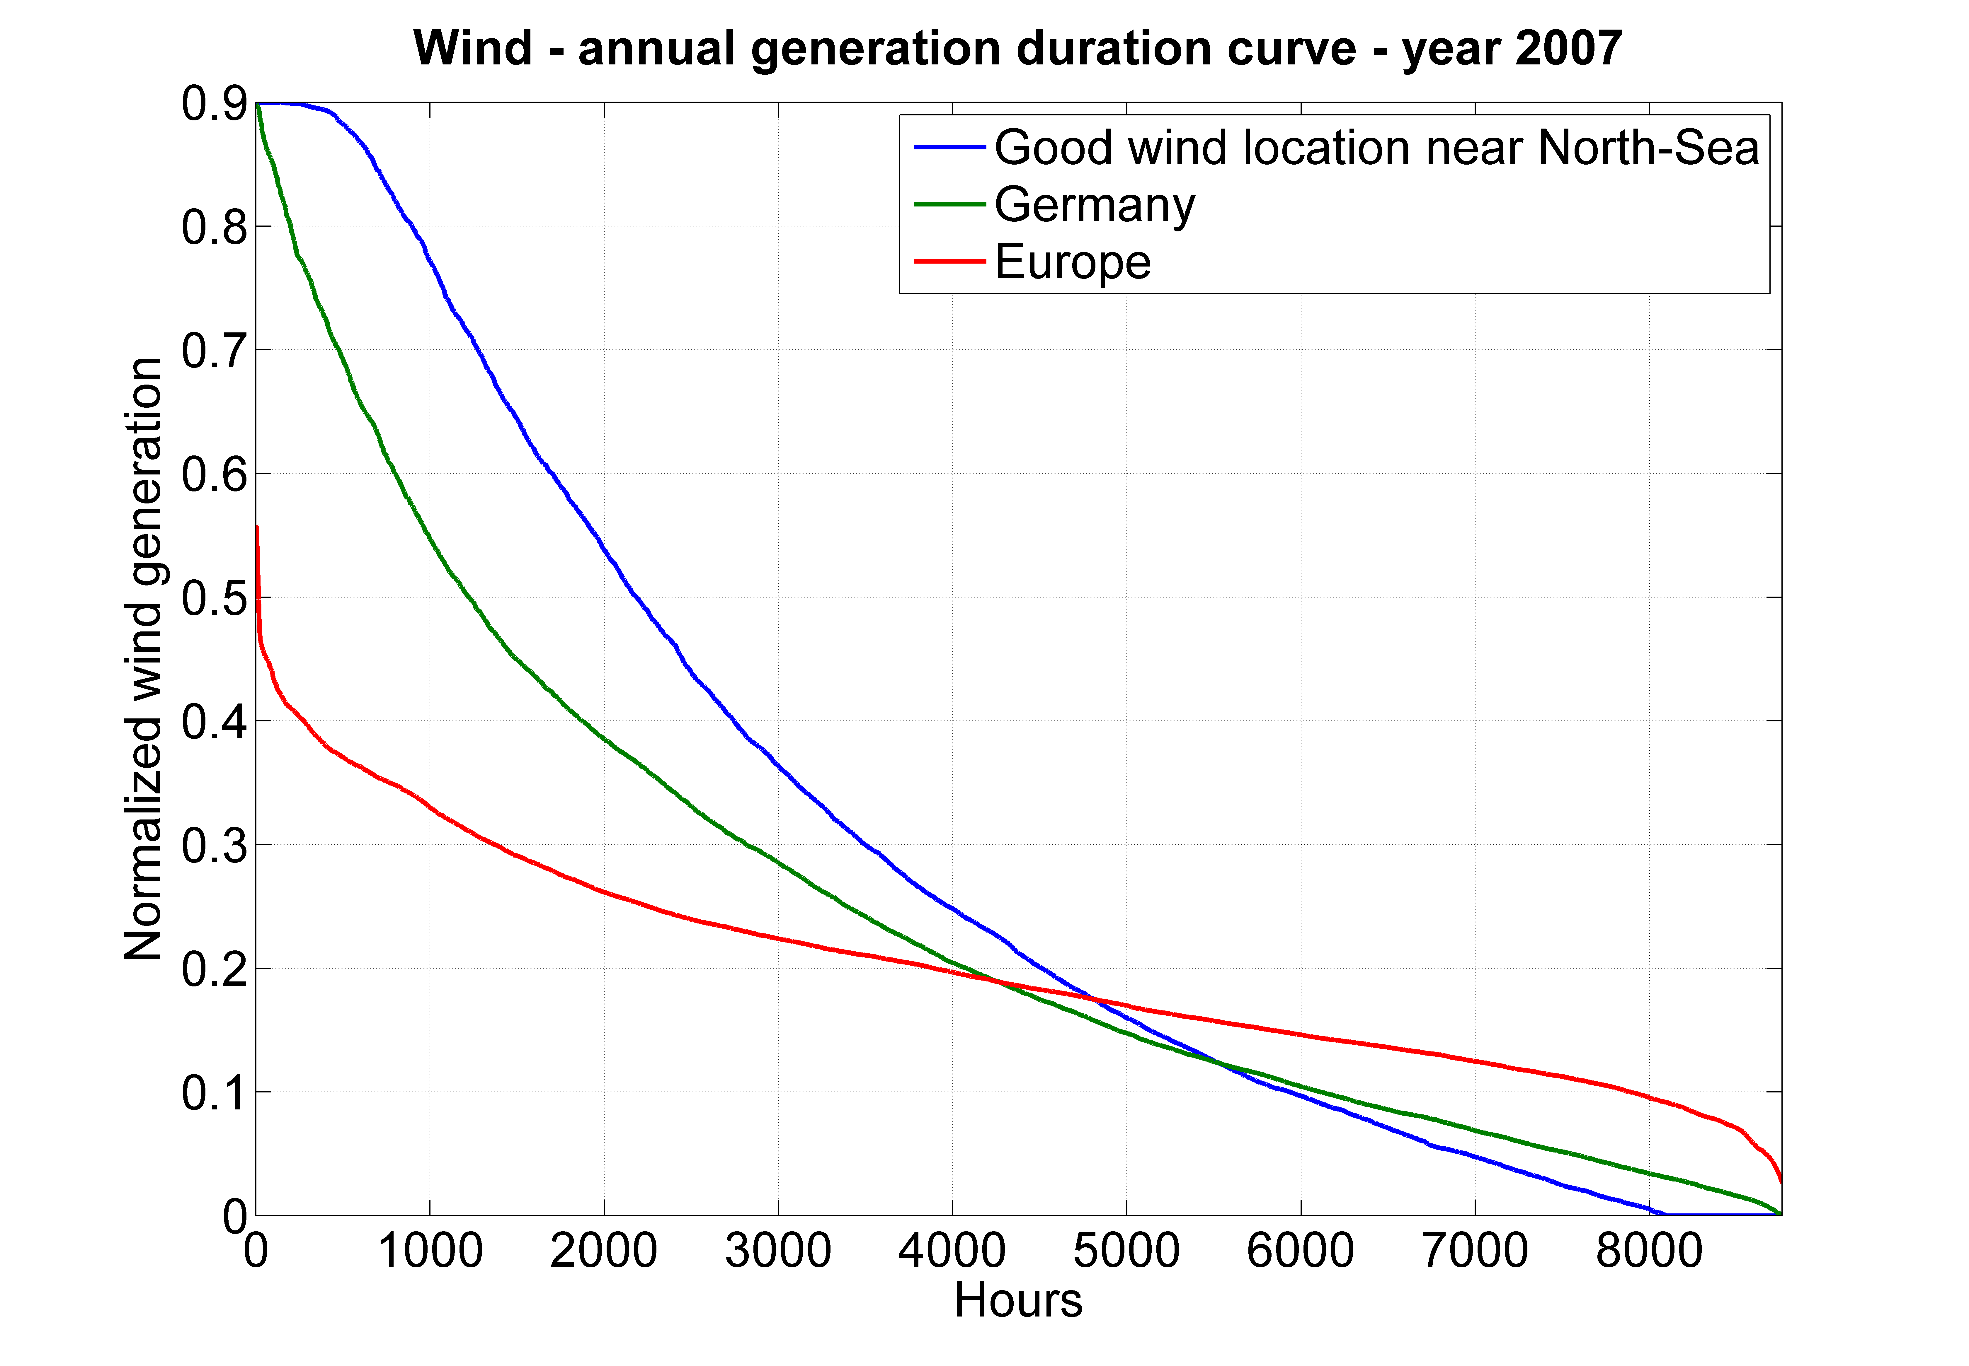
Warming up with wind-statistics
Source Janker

Slide 8
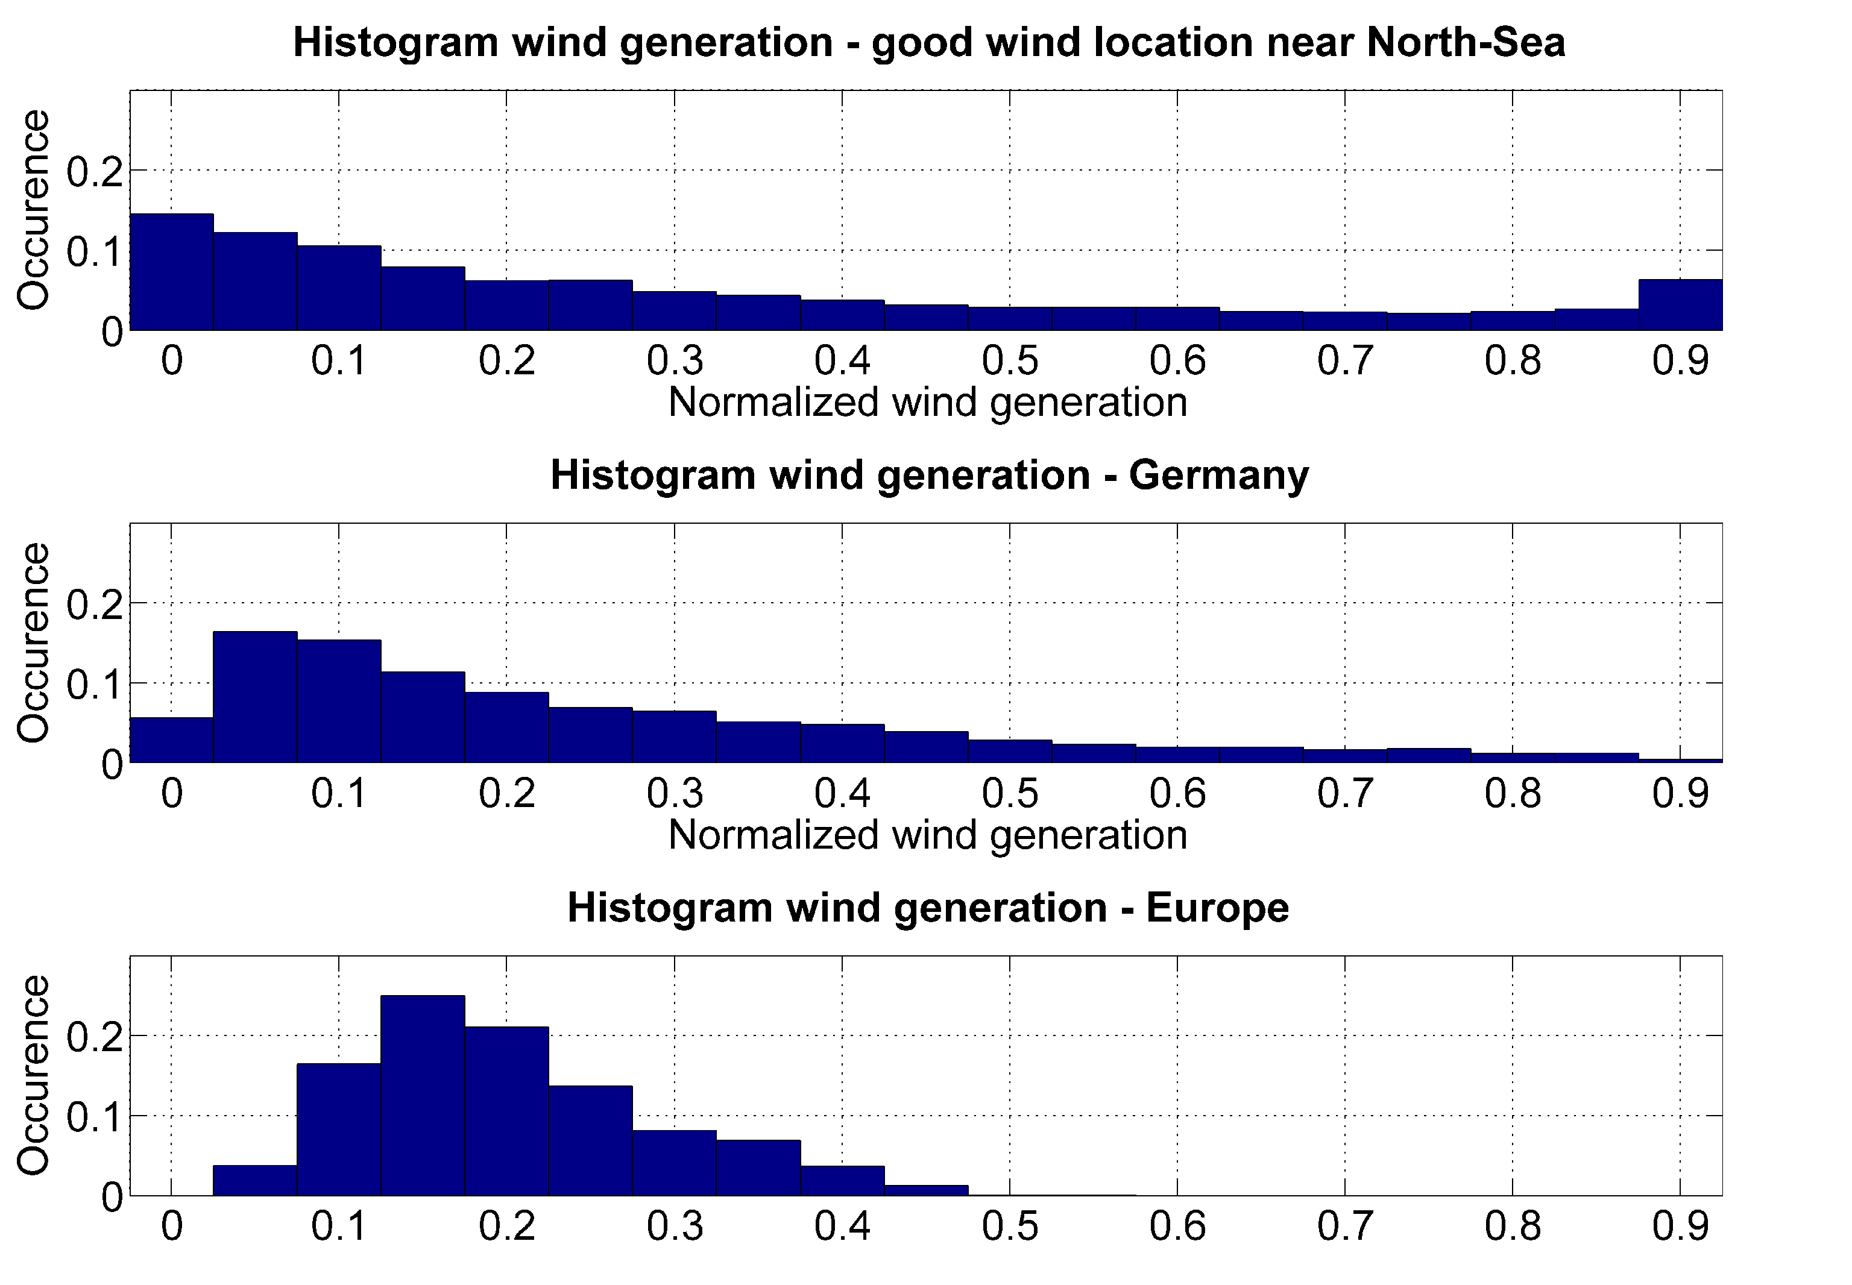
Warming up with wind-statistics
Source Janker

Slide 9
A model to describe future power markets (URBS)
The year 2050 is modelled
Each country is a node in the model
New investments and power plant
scheduling are the result of cost
minimisation
Wind and PV are described by hourly
resolved time series

Slide 10
The model: assumptions
Technology | Investment Cost | Fix Cost | Lifetime
 | [€/kW] | [€/kW] | [a]
CCGT | 750 | 11 | 30
PV- rooftop | 1080 | 29 | 25
PV- utility | 801 | 22 | 25
Wind-on | 932 | 31 | 25
Wind-off | 1495 | 60 | 20
Biomass | 2450 | 80 | 25
Region | Electricity demand [TWh]
Europe | 3000
Trukey | 509
MENA | 970
In the year 2050 CO2-emissions are
reduced by 95 % compared to the
year 1990.

Slide 11
Wind as low cost option

Slide 12
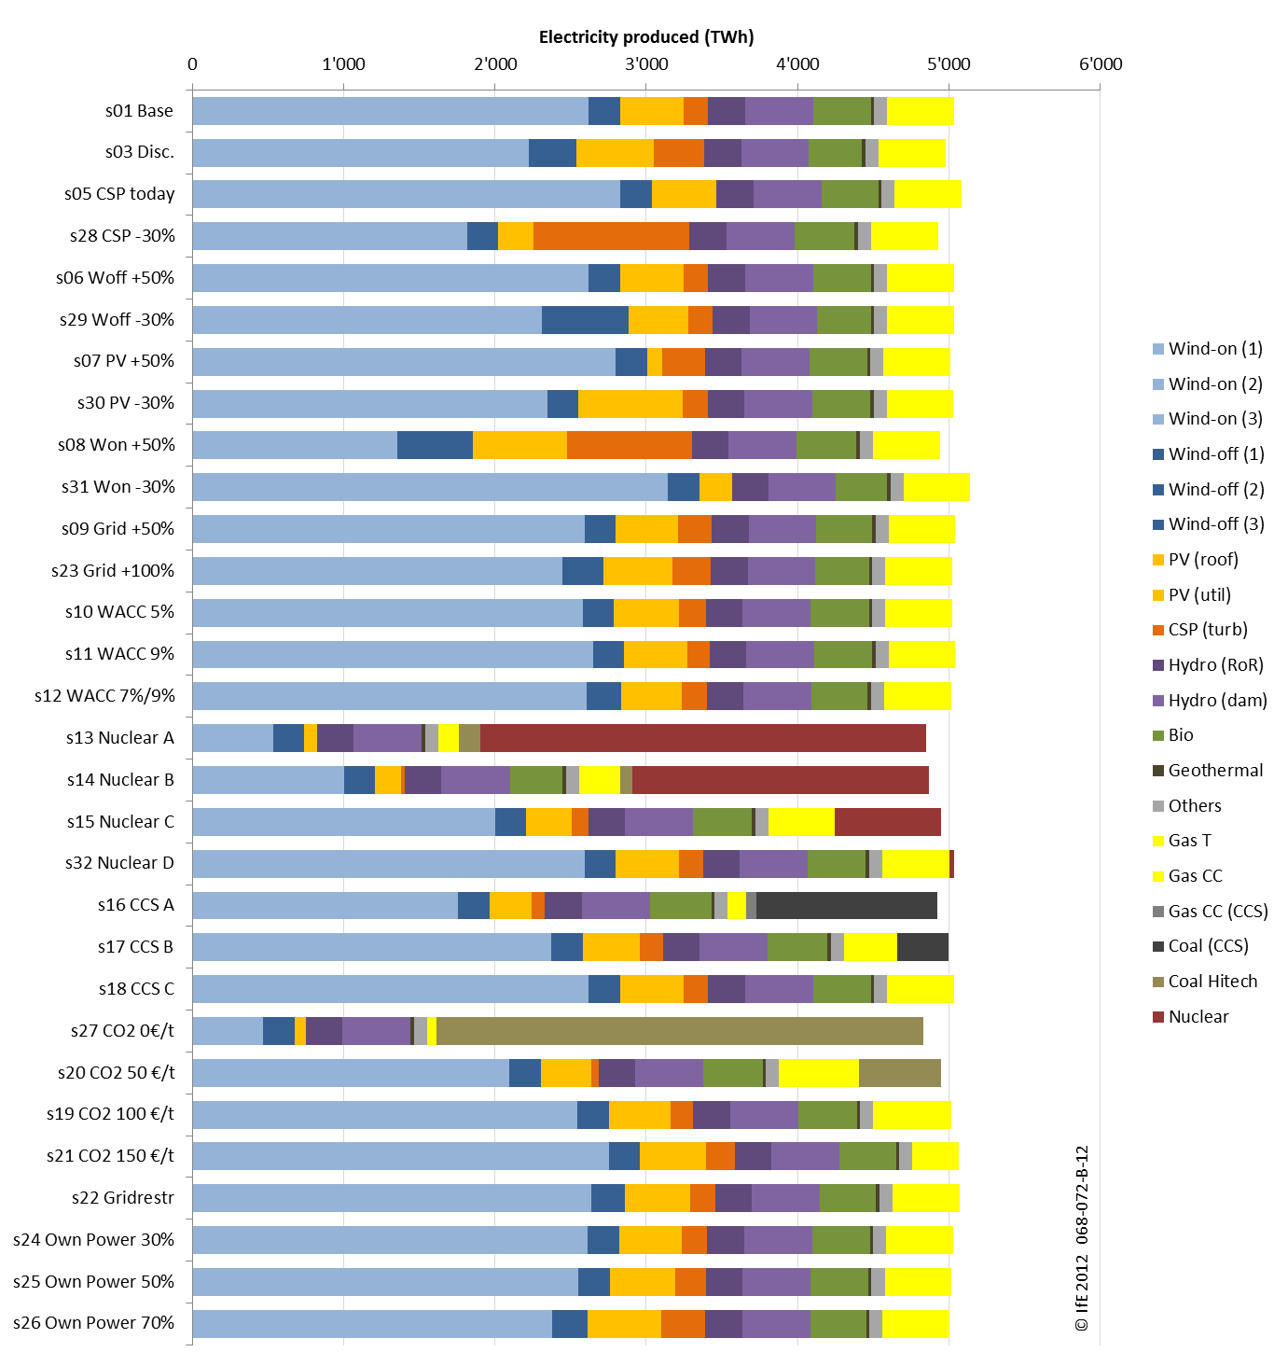
Results

Slide 13
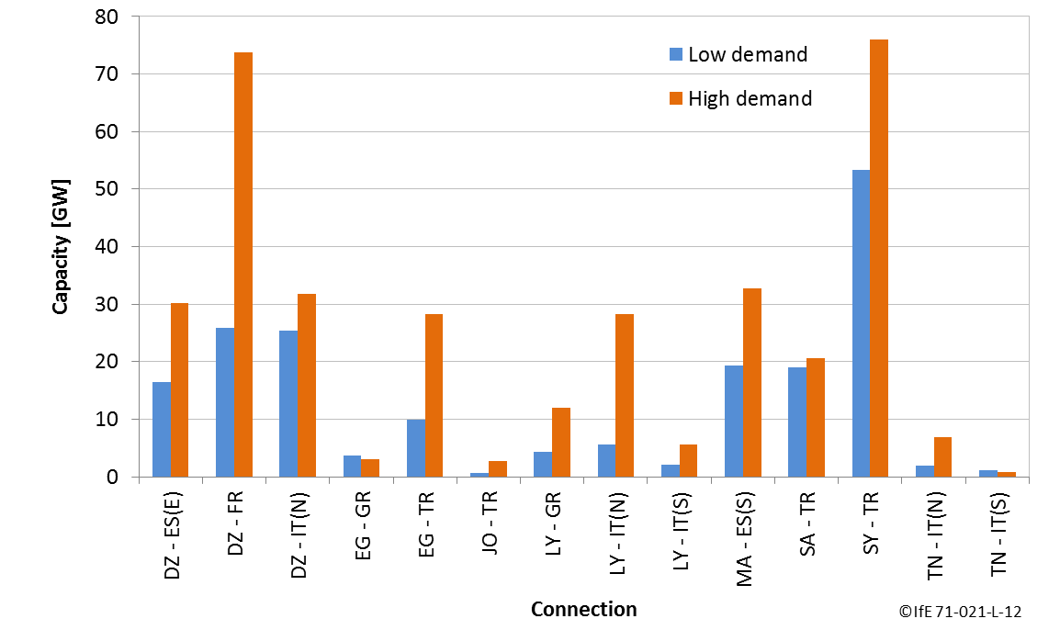

Slide 14
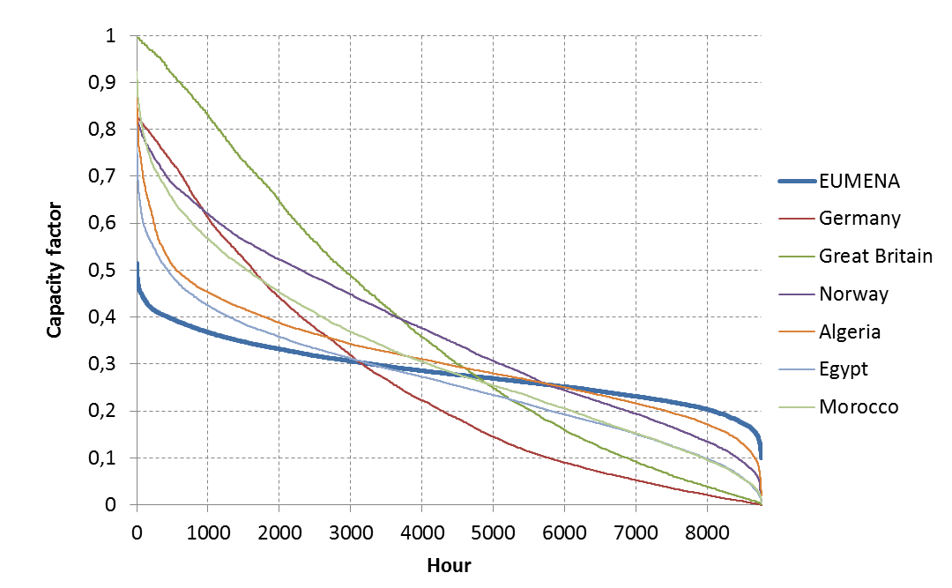
Results

Slide 15
Storage Option

Slide 16
Storage Option

Slide 17
Model IMAKUS – structure
Source: Kuhn, P.: Iteratives Modell zur Optimierung von Speicherausbau und –betrieb in einem Stromsystem mit zunehmend fluktuierender Erzeugung

Slide 18
Electricity Generation in Scenario with
15 % Lower Demand and 80 % Share of RES in 2050
Source: Kuhn, P; Kühne, M.; Heilek, C.: Integration und Bewertung erzeuger- und verbraucherseitiger Energiespeicher, KW21-Bericht, 2012

Slide 19
Storage expansion in Scenario with
15 % Lower Demand and 80 % Share of RES in 2050
Charging
Discharging
Capacity
Source:
Kuhn, P; Kühne, M.; Heilek, C.:
Integration und Bewertung erzeuger- und verbraucherseitiger Energiespeicher, KW21-Bericht, 2012

Slide 20
Storage capacity expansion – comparison of different scenarios
Source: Kuhn, P; Kühne, M.; Heilek, C.: Integration und Bewertung erzeuger- und verbraucherseitiger Energiespeicher, KW21-Bericht, 2012

Slide 21
Model predictive control of building automation

Slide 22
Conclusion
Large networks favour the integration of renewables, especially wind or
large networks would favour the penetration of wind.
A better understanding of storage requires a better understanding of
cross sector couplings and depends on the final mix.
Flexible demand is already possible in current systems (for example
building controls) but requires quite sophisticated prediction systems.

