Slide 1
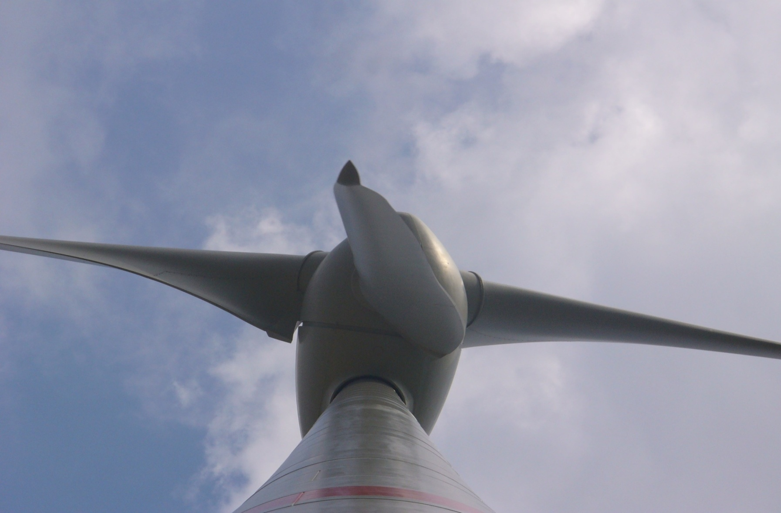
EASAC workshop at the Royal Academy , Stockholm, Sept. 19-20
Wind Energy Systems – Present Status and Ecobalances
Hermann-Josef Wagner
Institute for Energy Systems and Energy Economy
Ruhr-University Bochum, Germany
lee@lee.rub.de

Slide 2
Structure of my presentation
Present status of wind energy use
Cumulated Energy and Ecobalances
Results of the wind park alpha ventus

Slide 3
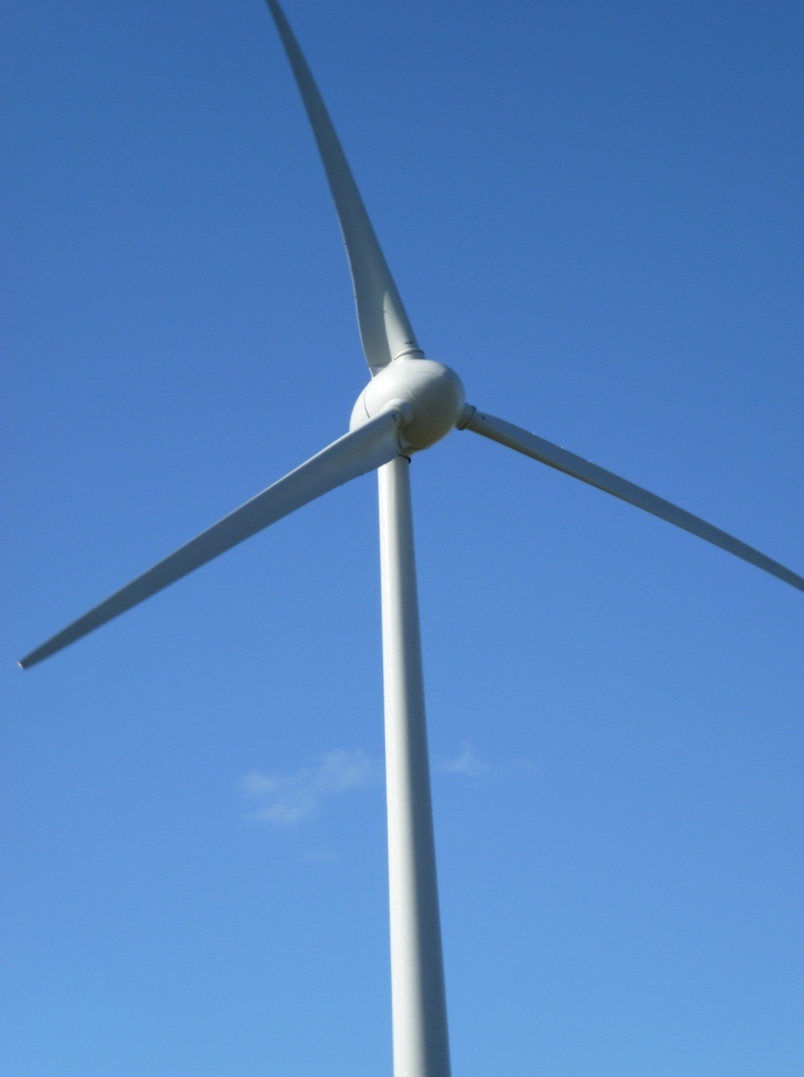
Electricity from wind energy
Status of installed wind power
 | Rated Capacity End of 2012 [GW] | Share worldwide [%]
China | 76 | 27
USA | 60 | 21
Germany | 31 | 11
Spain | 23 | 8
India | 18 | 6
Italy | 8 | 3
Great Britain | 9 | 3
France | 7 | 3
Canada | 6 | 2
Portugal | 5 | 2
Remaining countries | 40 | 14
Total | 283 | 100
Source: Global Wind Satistics; Global Wind Energy Council, www.gwec.net,
Status 10 Feb. 2013

Slide 4
Structure of my presentation
Present status of wind energy use
Cumulated Energy and Ecobalances
Results of the wind park alpha ventus

Slide 5
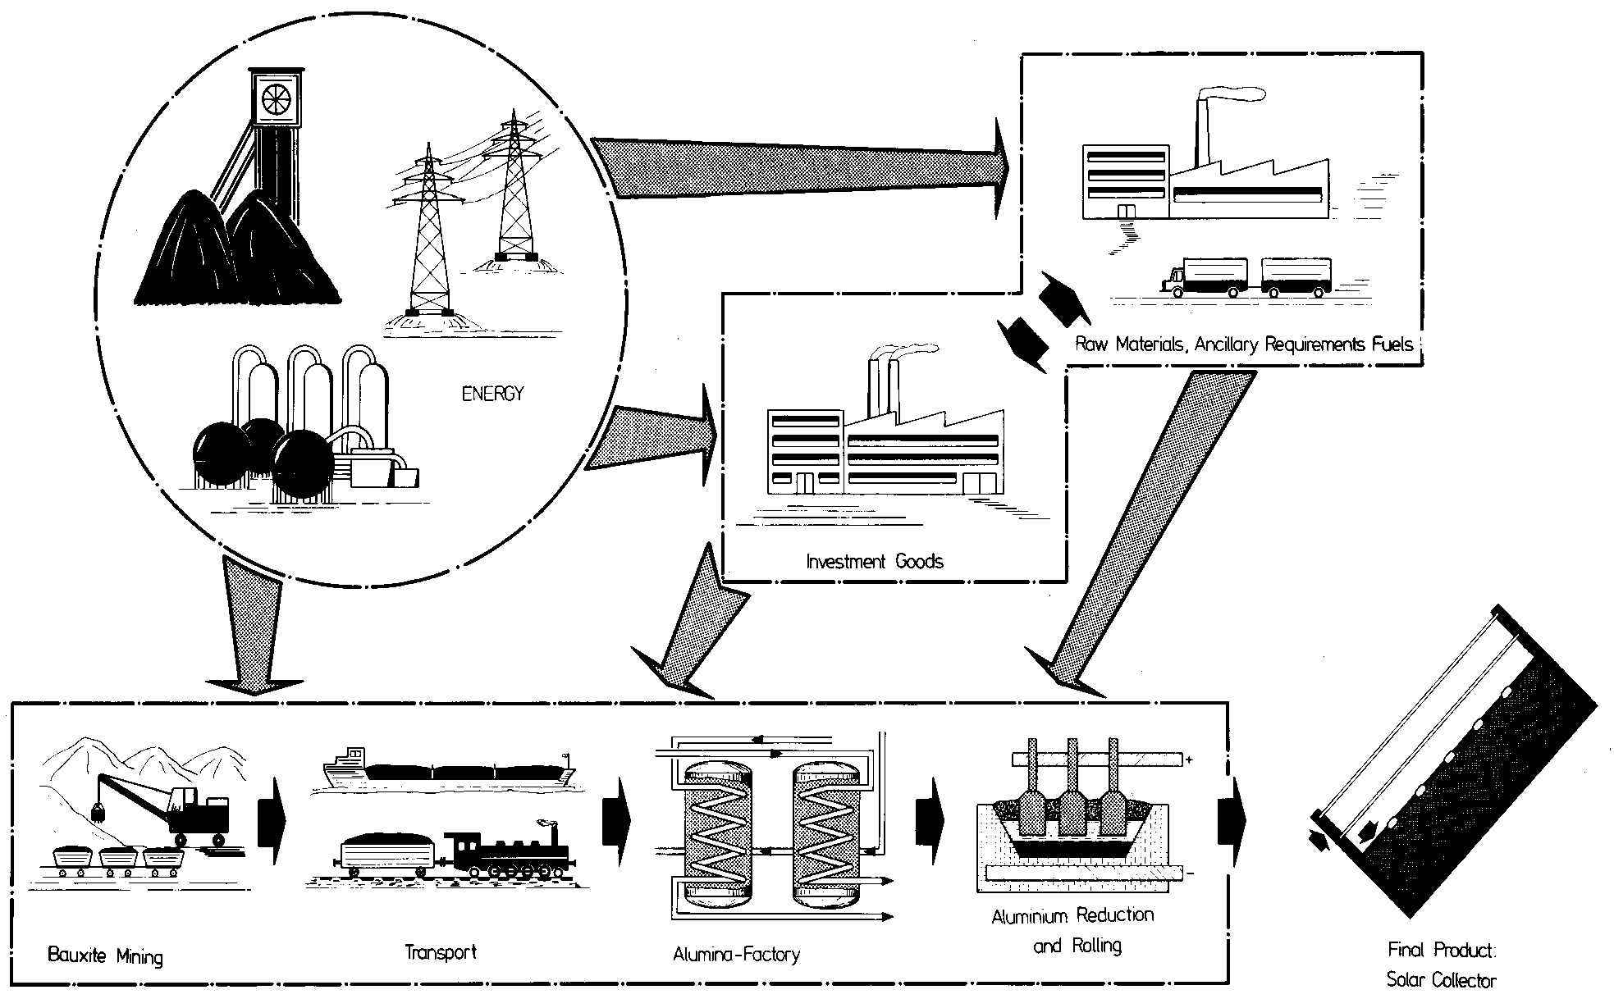
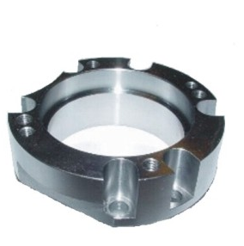
Example of Process-Chain-Analysis
Final Product:
Aluminium Component
Notes:
Nicht nur Energieträger betrachten sondern auch andere Materialien, z.B. Stah
Diversifizierung allein kann aber nicht ausreichend sein zur Betrachtung, Beispiel isländische Energieversorgung.

Slide 6
Process chain for final energy carrier
Example: Overall Efficiencies of Supply for final energy carrier
Problem: different forms of energy must be made comparable.
Electricity, oil-products, etc. are count back on primary energy with typical (country-specific) process chains.
The primary energy equivalent of electricity is 2,90 kWh (Overall Efficiencies of Supply g_{el}).
  Overall Efficiencies of Supply:
The primary energy equivalent of oil is 1,13 kWh (Overall Efficiencies of Supply g_{oil}).
Comment:
If there are enough information, you can devide the primary energy equivalent in a fossil, regenerative and nuclear share.

Slide 7
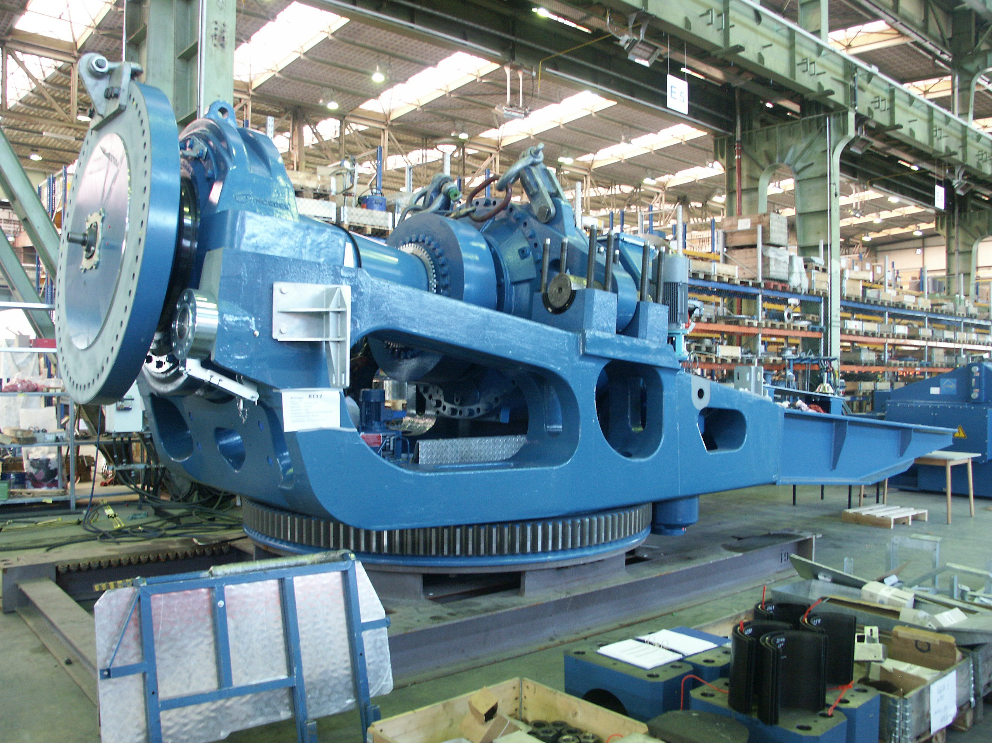
Assembling of a wind converter by Nordex AG
Source: Nordex AG
Notes:
7
7

Slide 8
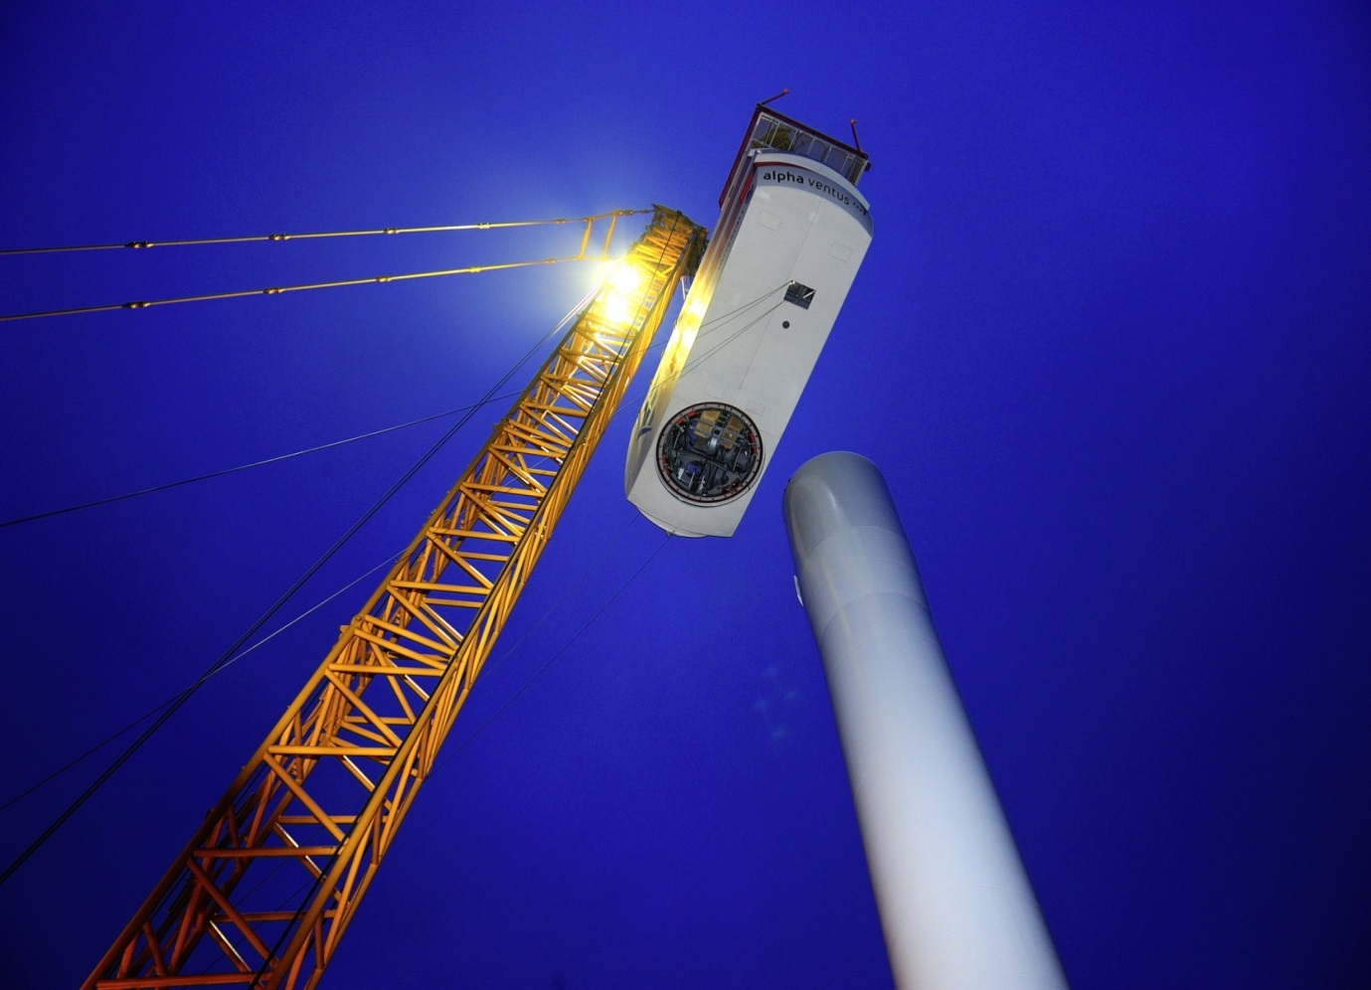
Montage of an cabin - windpak alpha ventus
© Doti 2009
Notes:
8

Slide 9
Structure of my presentation
Present status of wind energy use
Cumulated Energy and Ecobalances
Results of the wind park alpha ventus

Slide 10
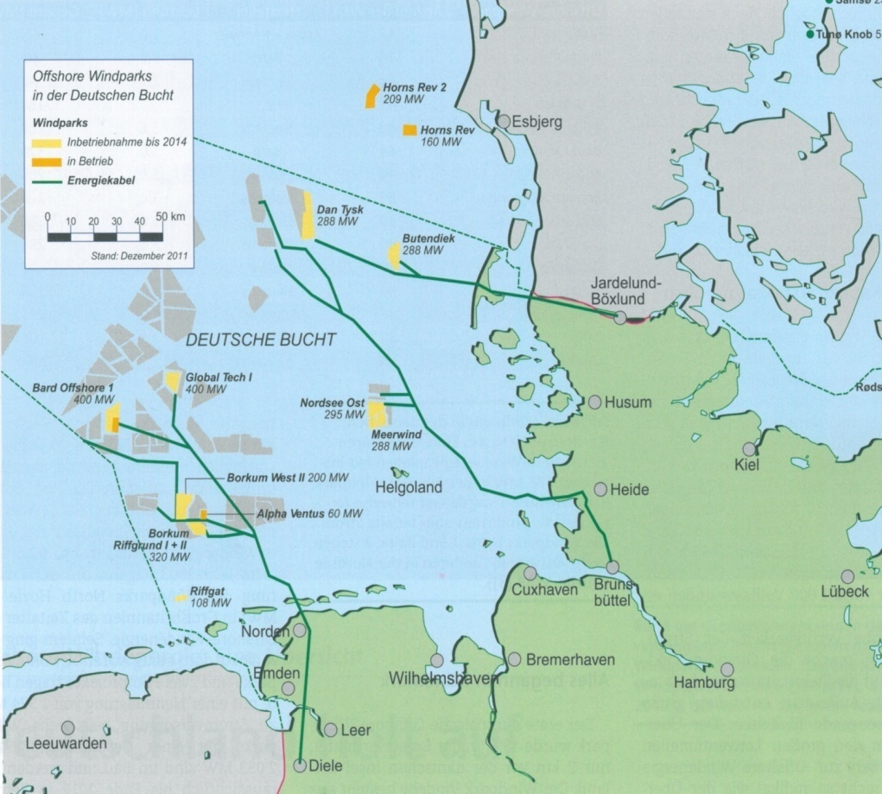
Planned offshore windparks and cable lines in Germany (North Sea, beginning of 2011)
The dark yellow projects are in operation (alpha ventus was the first), the soft yellow projects should be go in operation until 2014

Slide 11
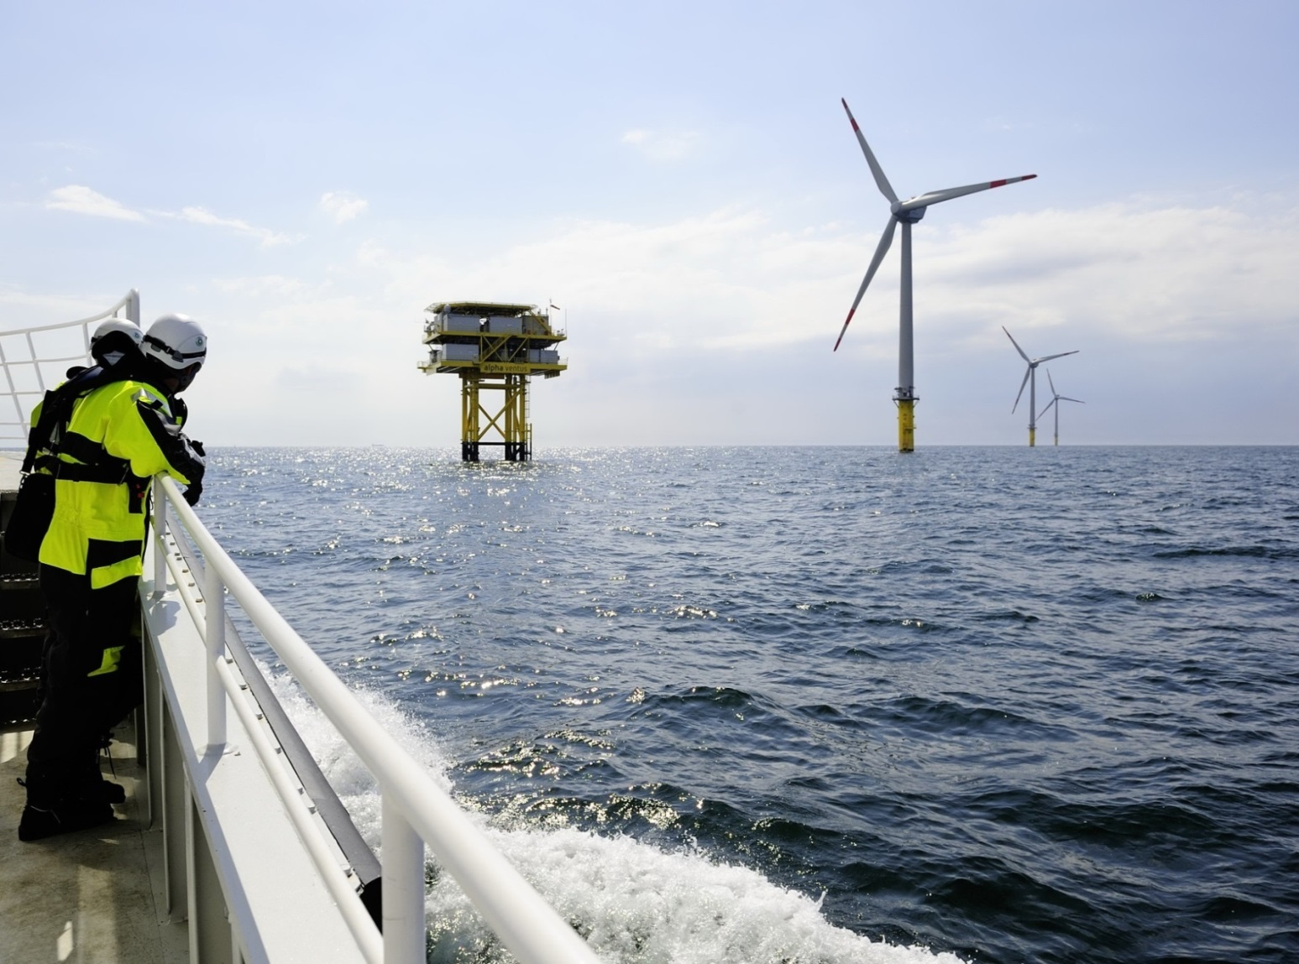
Windpark alpha ventus
© Doti 2009

Slide 12
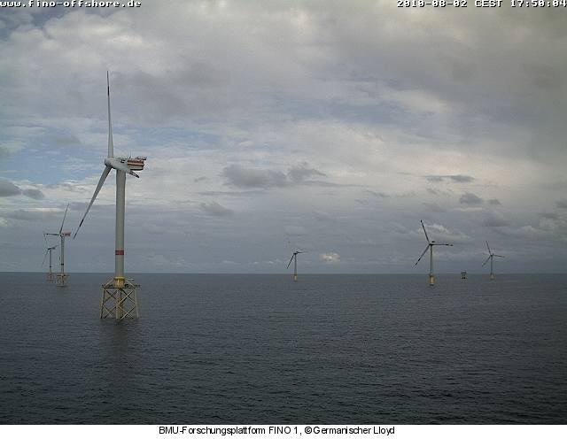
Life Cycle Analysis wind park alpha ventus
Reference system
12 Wind energy converter, each 5 MW
(6 of Multibrid and 6 of REpower company)
Operation time 20 years
Lifetime foundation 20 years
Capacity Factor 45% (load duration 3900 h/a):
incl. maintenance- and failure times, power consumption of WEC and transmission platform inside wind park
Maintenance and services:
Change of 1/2 gearbox per station and operation time
Change of 1,25 rotor blades per station and operation time
120 helicopter transports per year for the wind park
180 ship transports per year for the wind park

Slide 13
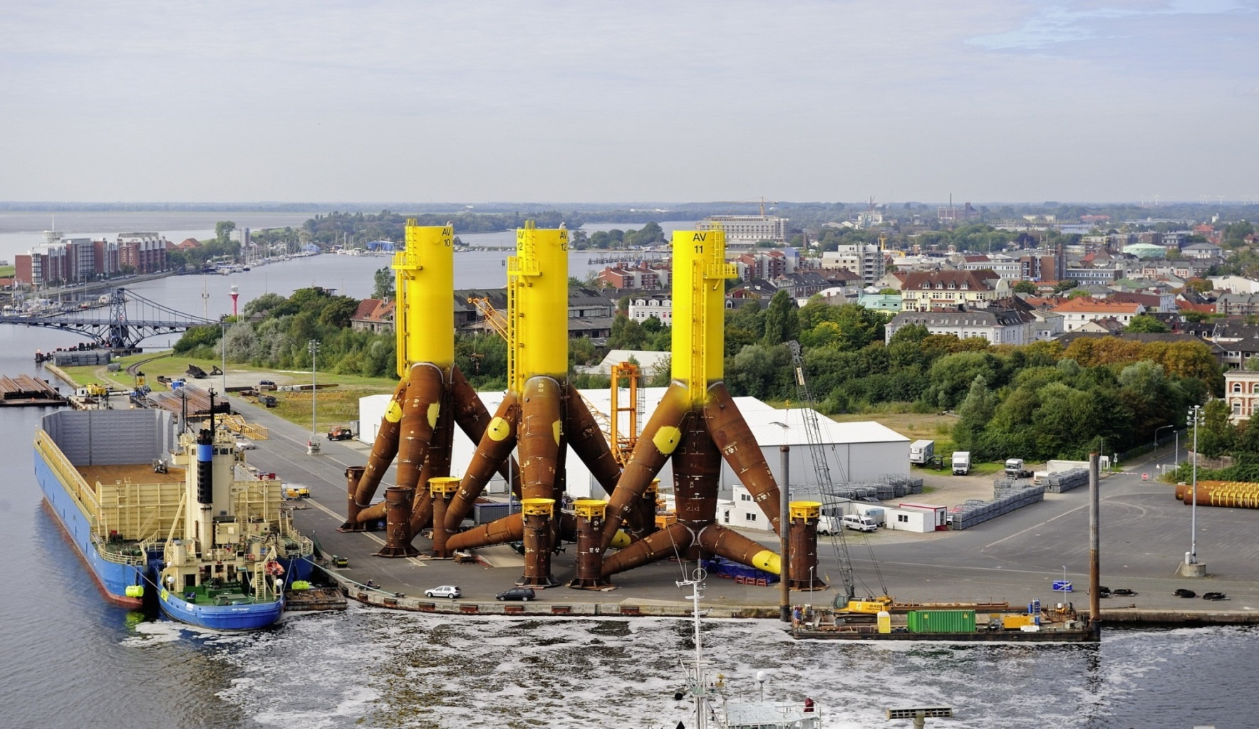
Fundaments for windmills for alpha ventus
Tripods for the Multibrid windmills
© Doti 2009
Notes:
13

Slide 14
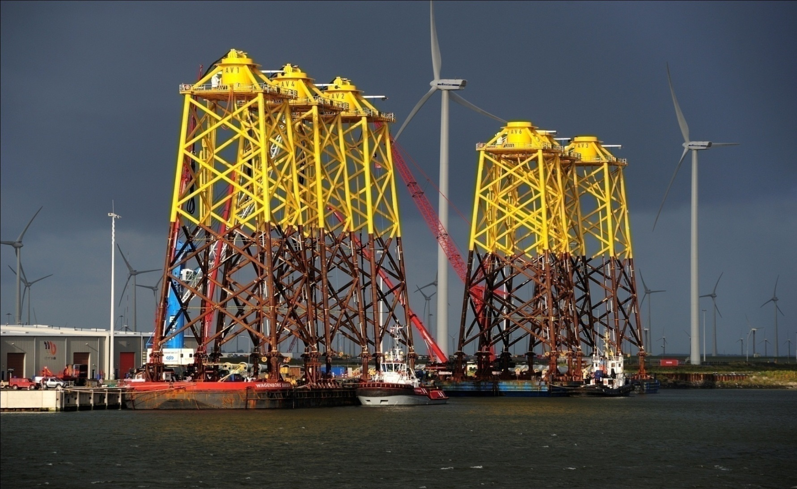
Fundaments for windmills for alpha ventus
Jackets for the Repower windmills

Slide 15
Results production of 1x Multibrid M5000
Material balance

Slide 16
Results production of 1x REpower 5M
Material balance

Slide 17
Results of the wind park alpha ventus
Cumulated Energy Demand(CED) and
Global Worming Potential (GWP)

Slide 18
Results wind park alpha ventus
CED – Life Cycle and use time

Slide 19
Results wind park alpha ventus
GWP – Life Cycle and use time

Slide 20
Results wind farm alpha ventus
CED and GWP – Life cycle – by elements

Slide 21
Example of details: production grid connection

Slide 22
Energy Payback Time (EPT)
Energy Payback Time (EPT):
=
+
+
Substituted
fossil energy
Energy supply
for construction, operating
and disposal
Notes:
Nicht nur Energieträger betrachten sondern auch andere Materialien, z.B. Stah
Diversifizierung allein kann aber nicht ausreichend sein zur Betrachtung, Beispiel isländische Energieversorgung.

Slide 23
Energy and CO2 Payback Time
Reference System: 12 WEC - Lifetime Foundation 20 a – load duration 3900 h/a – Maintenance: ½ Gearbox, 15 Rotorplates, 120 Helicopter , 180 Ship transports

Slide 24
Results of the wind park alpha ventus
All considered eco-indicators

Slide 25
Possible effect-classes and -indicators in Life Cycle Analysis (1)

Slide 26
Possible effect-classes and -indicators in Life-Cycle Analysis (2)

Slide 27
Classification of the results
Comparison with German Power Mix (uniform ranking)

Slide 28
Conclusions
The use of wind energy is worldwide growing
Wind energy is very material intensive → that needs energy
→ emissions
Ecobalances give information about sustainability
The energetic and CO₂ payback time for wind parks is about one year and less
Electricity from wind is much more sustainable as electricity from fossils
A sustainability check must be part of every planning of new energy systems

Slide 29
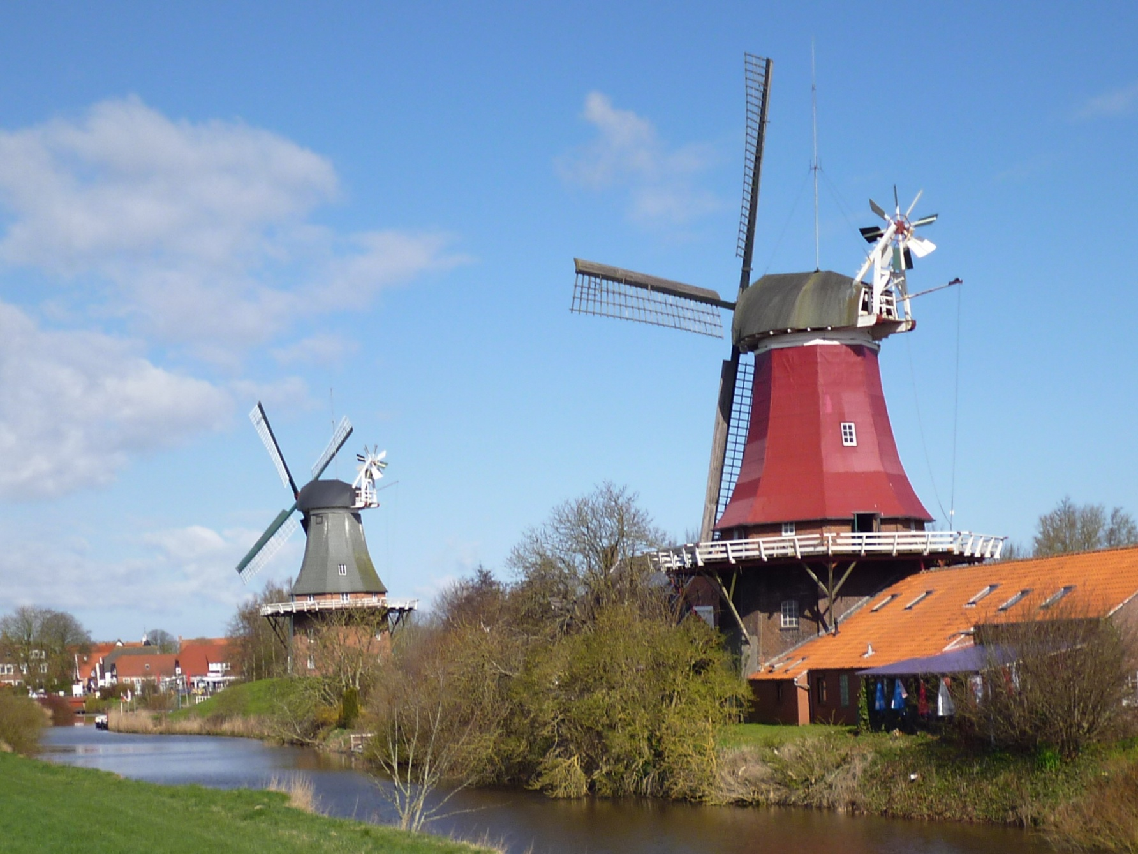
Thank you for your attention
History Wind mills in the Netherlands

Slide 30
For Discussion

Slide 31
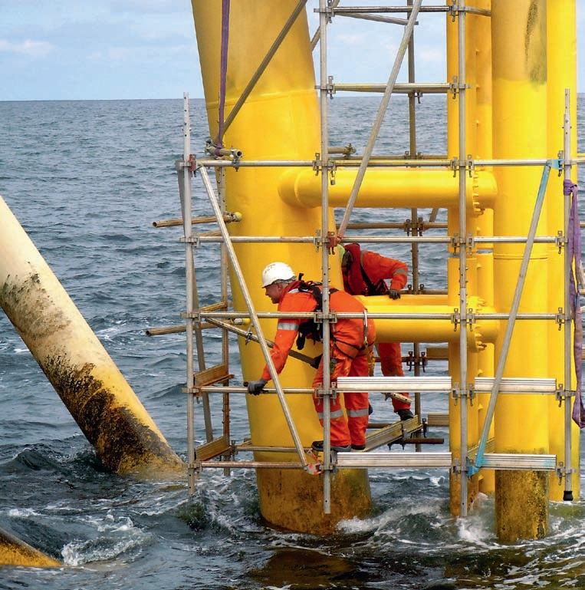
Maintenance: Repair of corrosion protection
Photo: Helmut Müller; Sonne, Wind und Wärme 4/2012
This foto was not made in wind park alpha ventus

Slide 32
Results production 6x Multibrid M5000
Cumulated energy demand

Slide 33
Results production 6x REpower 5M
Cumulated energy demand

Slide 34
Results production 6x Multibrid M5000
Global warming potential

Slide 35
Results production 6x REpower 5M
Global warming potential

Slide 36
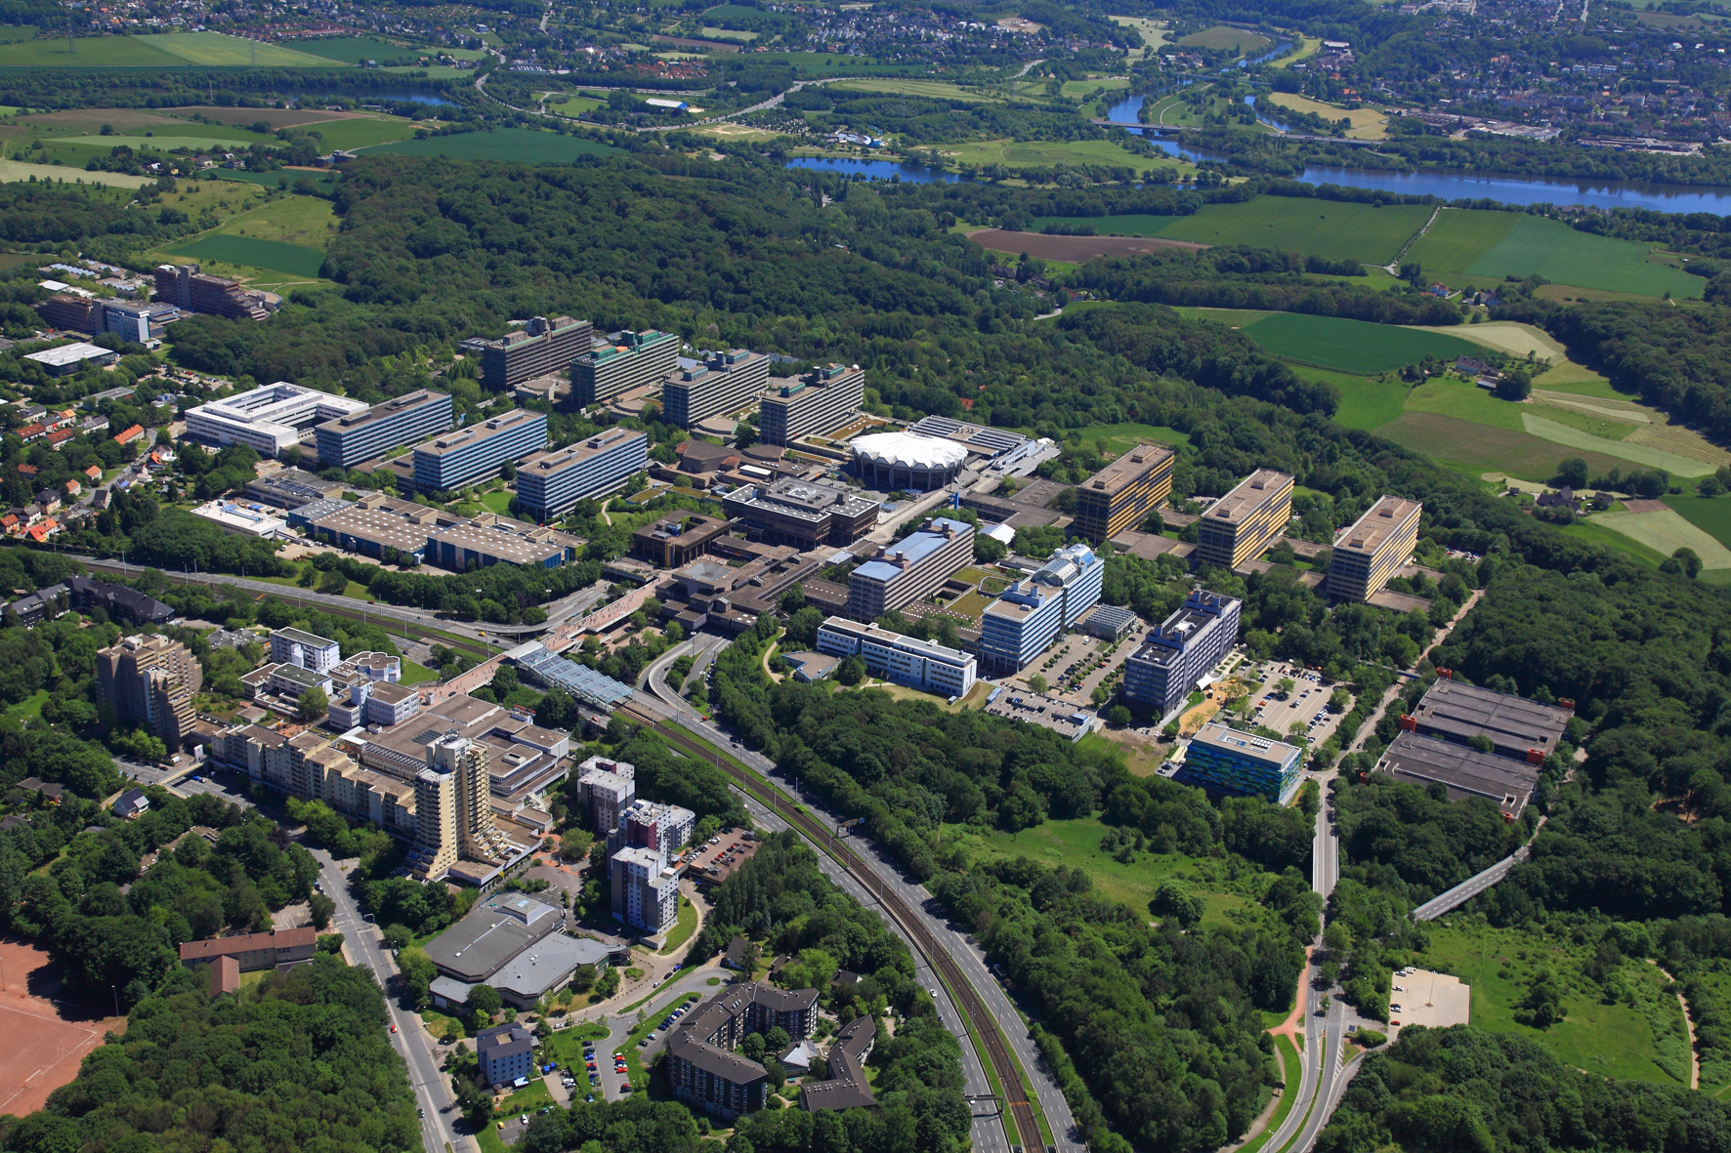
Around 5,600 employees
36,140 students in total
488 doctoral students
2,615 international students
20 faculties
462 million Euros revenue, of which from outside funding 95 million Euros
RUB Research School, funded by the Excellence Initiative of German Government
Ruhr Universität Bochum – Facts

